Slide 1
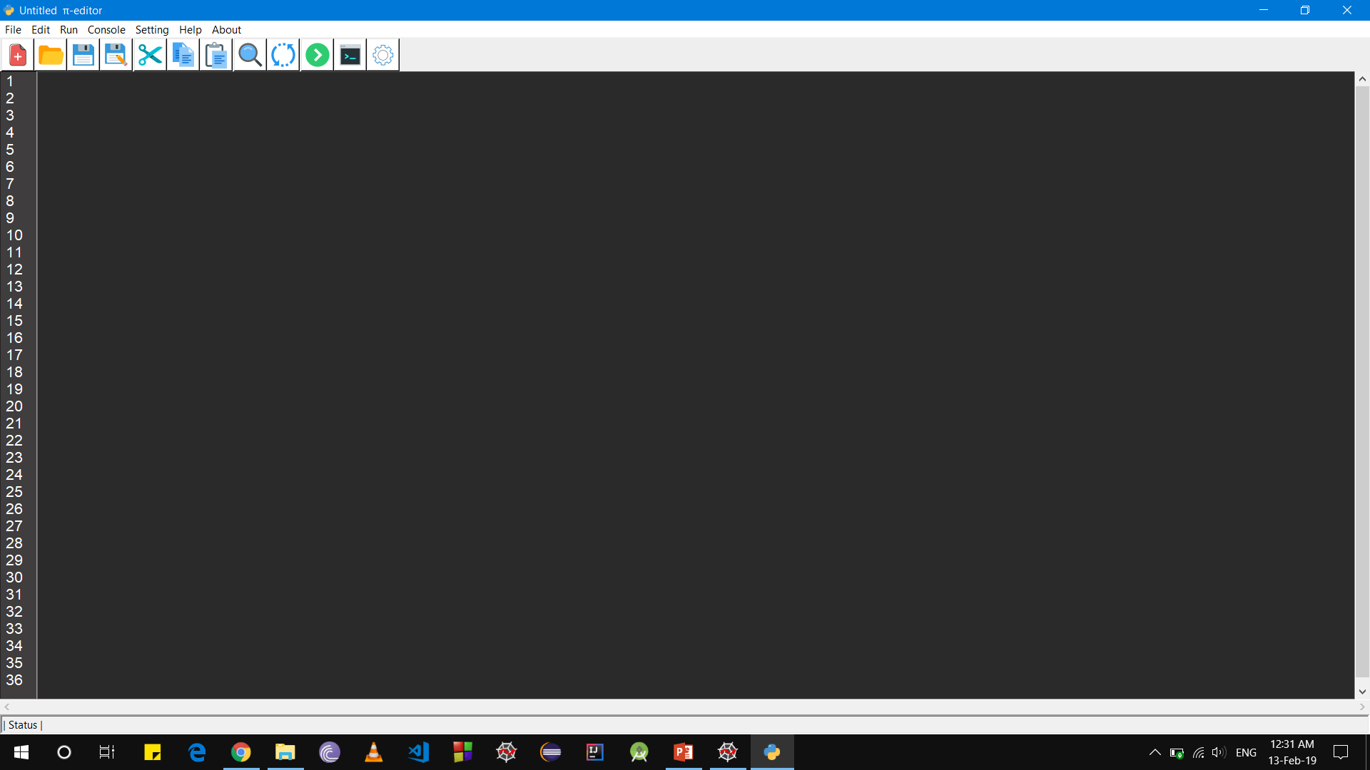
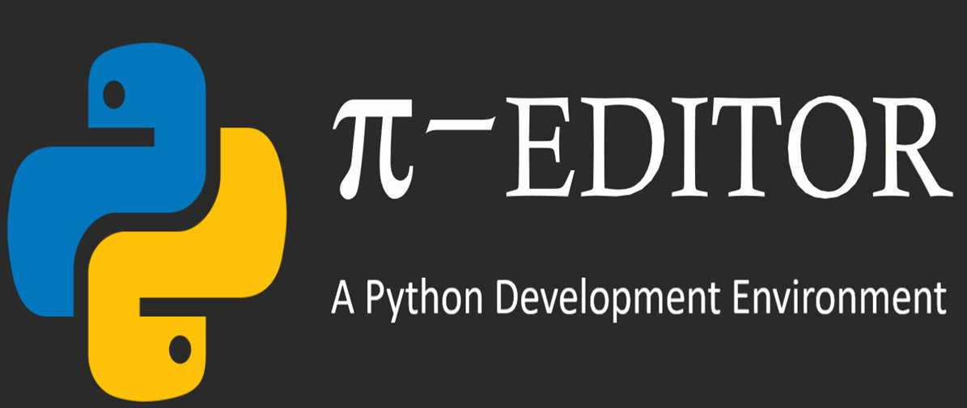
π-EDITOR
A Python Development Environment

Slide 2
PRESENTATION OUTLINE
PRESENTATION OUTLINE
-> Introduction
-> Objective
-> Why us?
-> Requirement
-> Some Snapshots
-> Design
-> Features Overview
-> Working
-> Features(Explanation)
-> Demo
-> Q/A

Slide 3
INTRODUCTION
INTRODUCTION
π-editor is a tool which provides Python Development Environment for your programs. It is designed not just to edit your code, it also comes with an added feature which allows you to run your code directly. It is based on Python 3 in which Tkinter library provides a smooth running GUI. It provides a GUI which is customizable according to user’s need which makes it more user-friendly and practical for day to day use

Slide 4
OBJECTIVE
OBJECTIVES
Notepad are used by a wide variety of people, for a wide variety of purposes. Software programmers use Notepad to write and edit their codes. But it consumes their valuable time to go and run their program by CMD .
If the user use IDES some of the IDE was large in size and expensive, some of them are slow and some of them were too much complicated to use
Our main objective is to provide an simple and easy to use environment to open, view, write, and run python program .This is one of the primary purposes of π-editors, unlike notepad π-editor comes with many other features to help users to code easily .

Slide 5
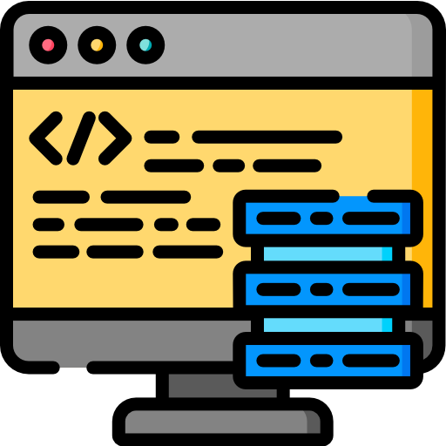


OBJECTIVE
WHY US?
Easy To Use Environment
To Write, edit & View Your Code
Customizable Environment
According to user need‘s
Save time
And increase work efficiency
π-EDITOR IS AN IDEAL TOOLS FOR ANYONE WHO NEEDS TO CODE SIMPLY AND EASILY.

Slide 6
REQUIREMENTS
REQUIREMENTS
-> OS Requirement : Windows 7/8/8.1/10.
-> Prerequisites : Pre-installed Python 3.
-> Processor : Intel Atom® processor or Intel® Core™ i3 processor.
-> Space Required: 18MB.
-> RAM : 1GB (recommended) or more.
-> Display option : Monitor.
-> Input devices : Keyboard, mouse.

Slide 7
SOME SNAPSHOTS

Slide 8
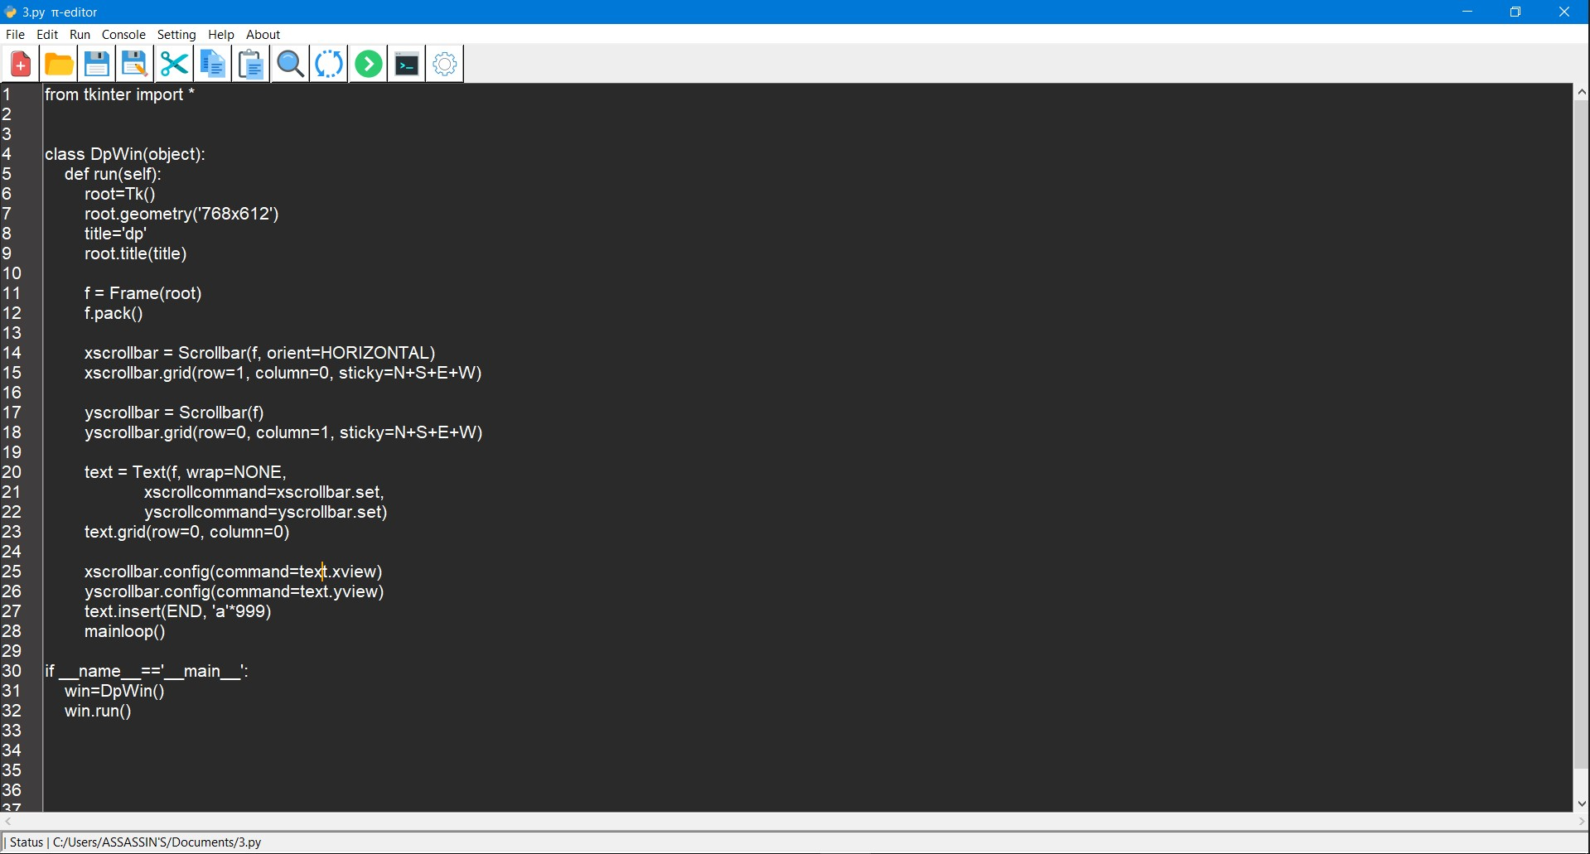
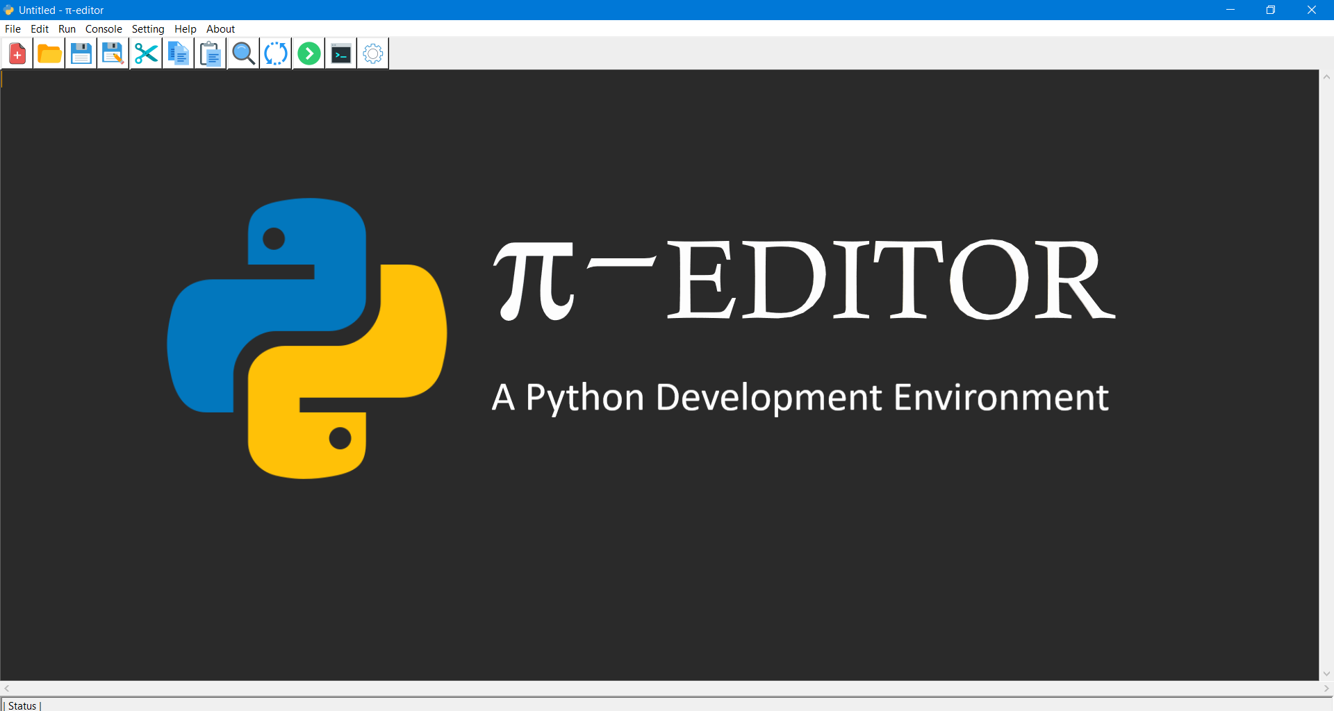

Slide 9
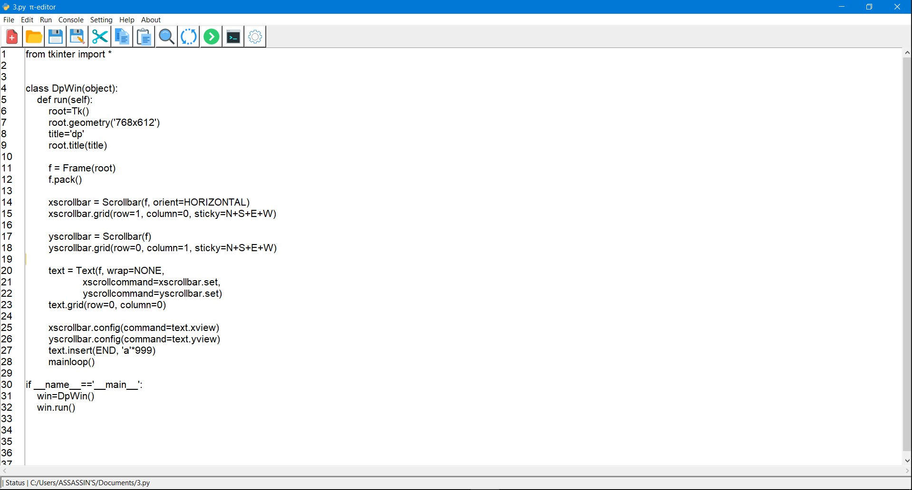
π-EDITOR
A Python Development Environment

Slide 10
DESIGN

Slide 11
MENU BAR
TOOL BAR
LINE BAR
STATUS BAR
SCROLL BAR

Slide 12
WORKING

Slide 13
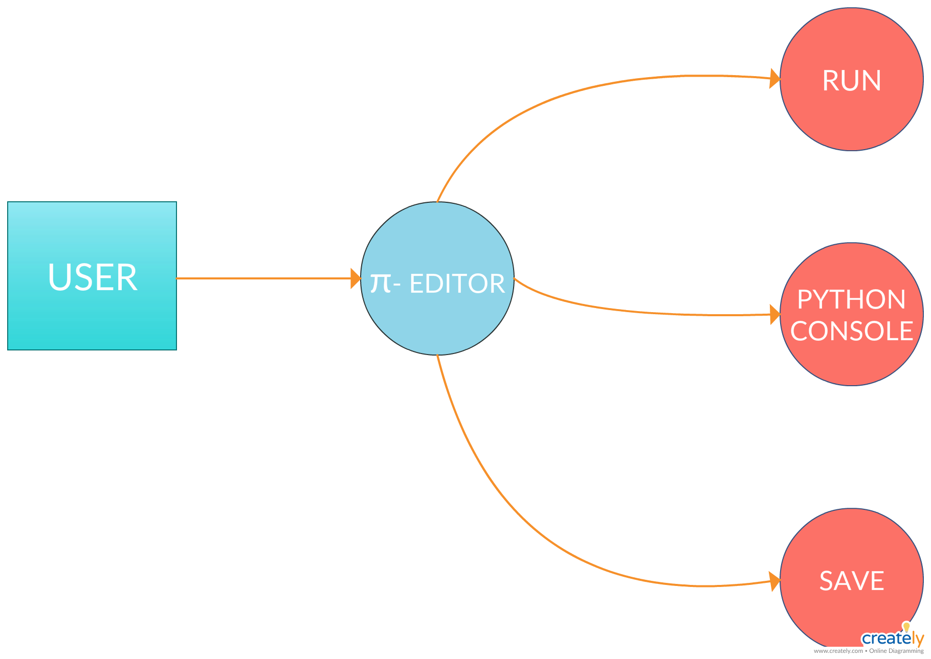

Slide 14
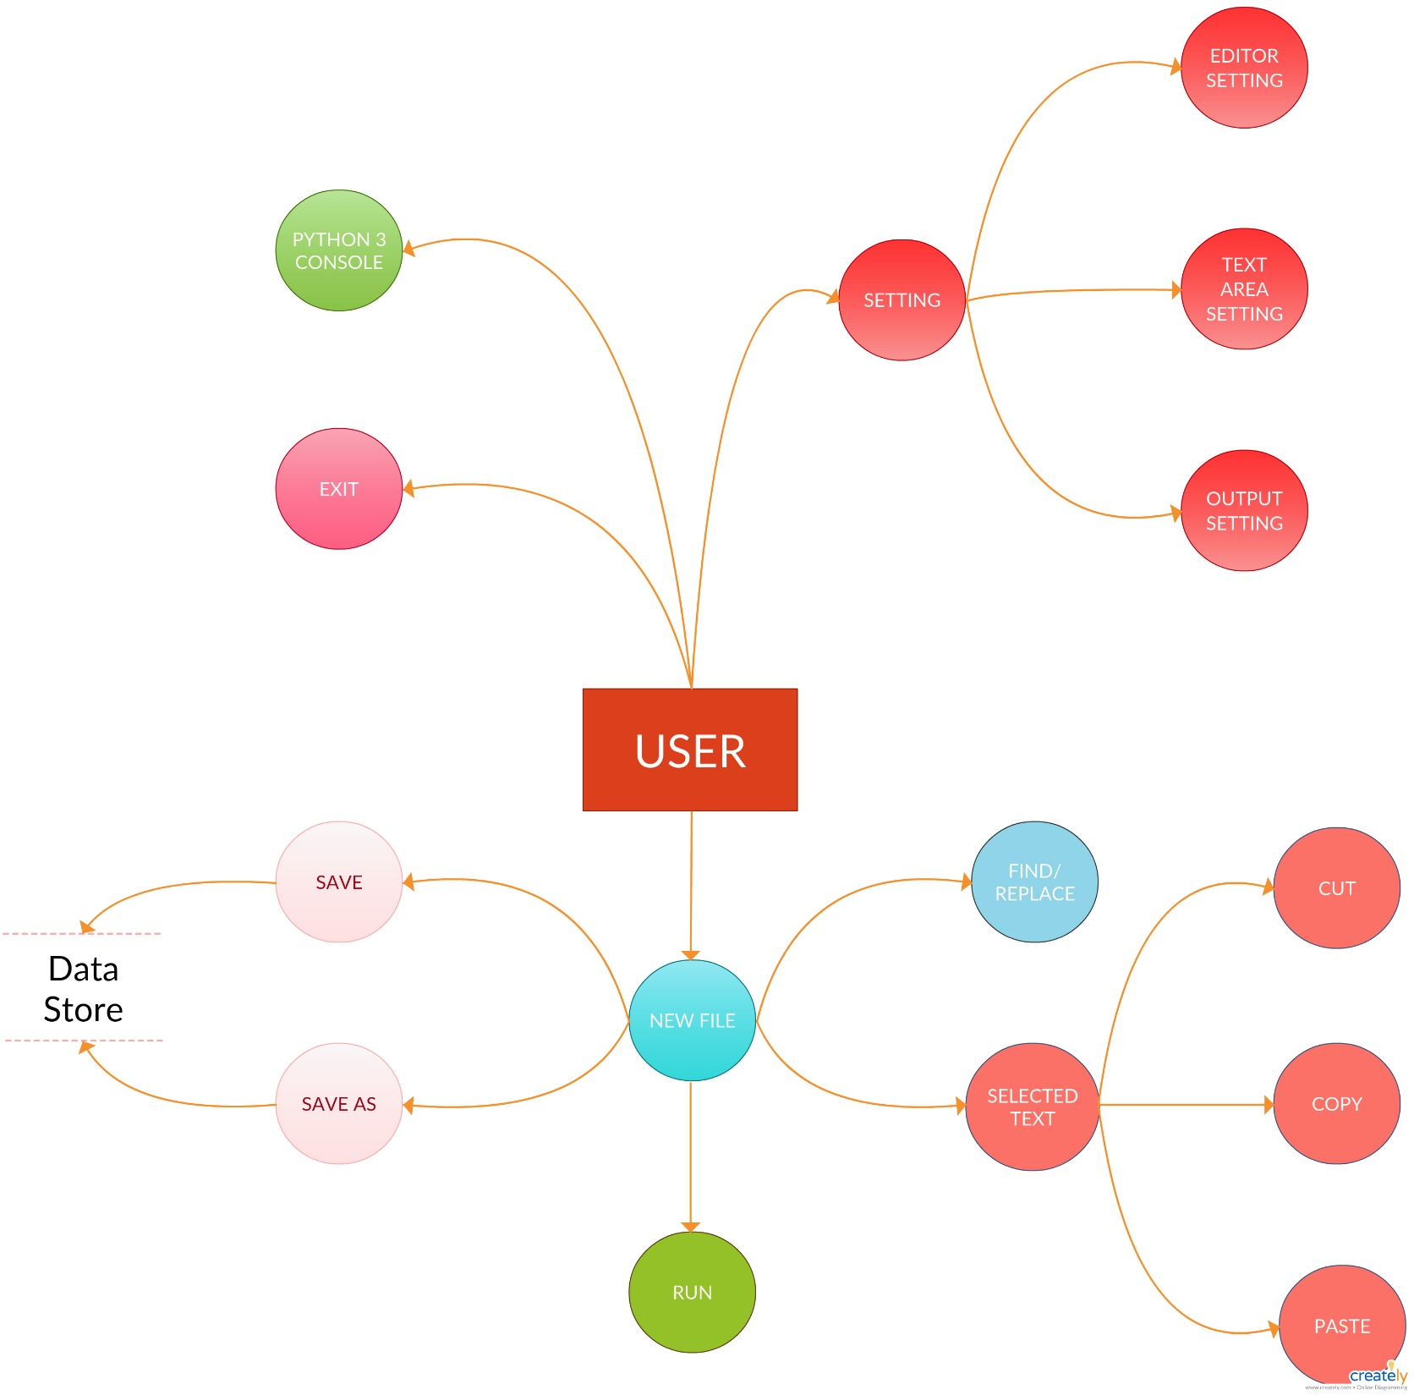

Slide 15
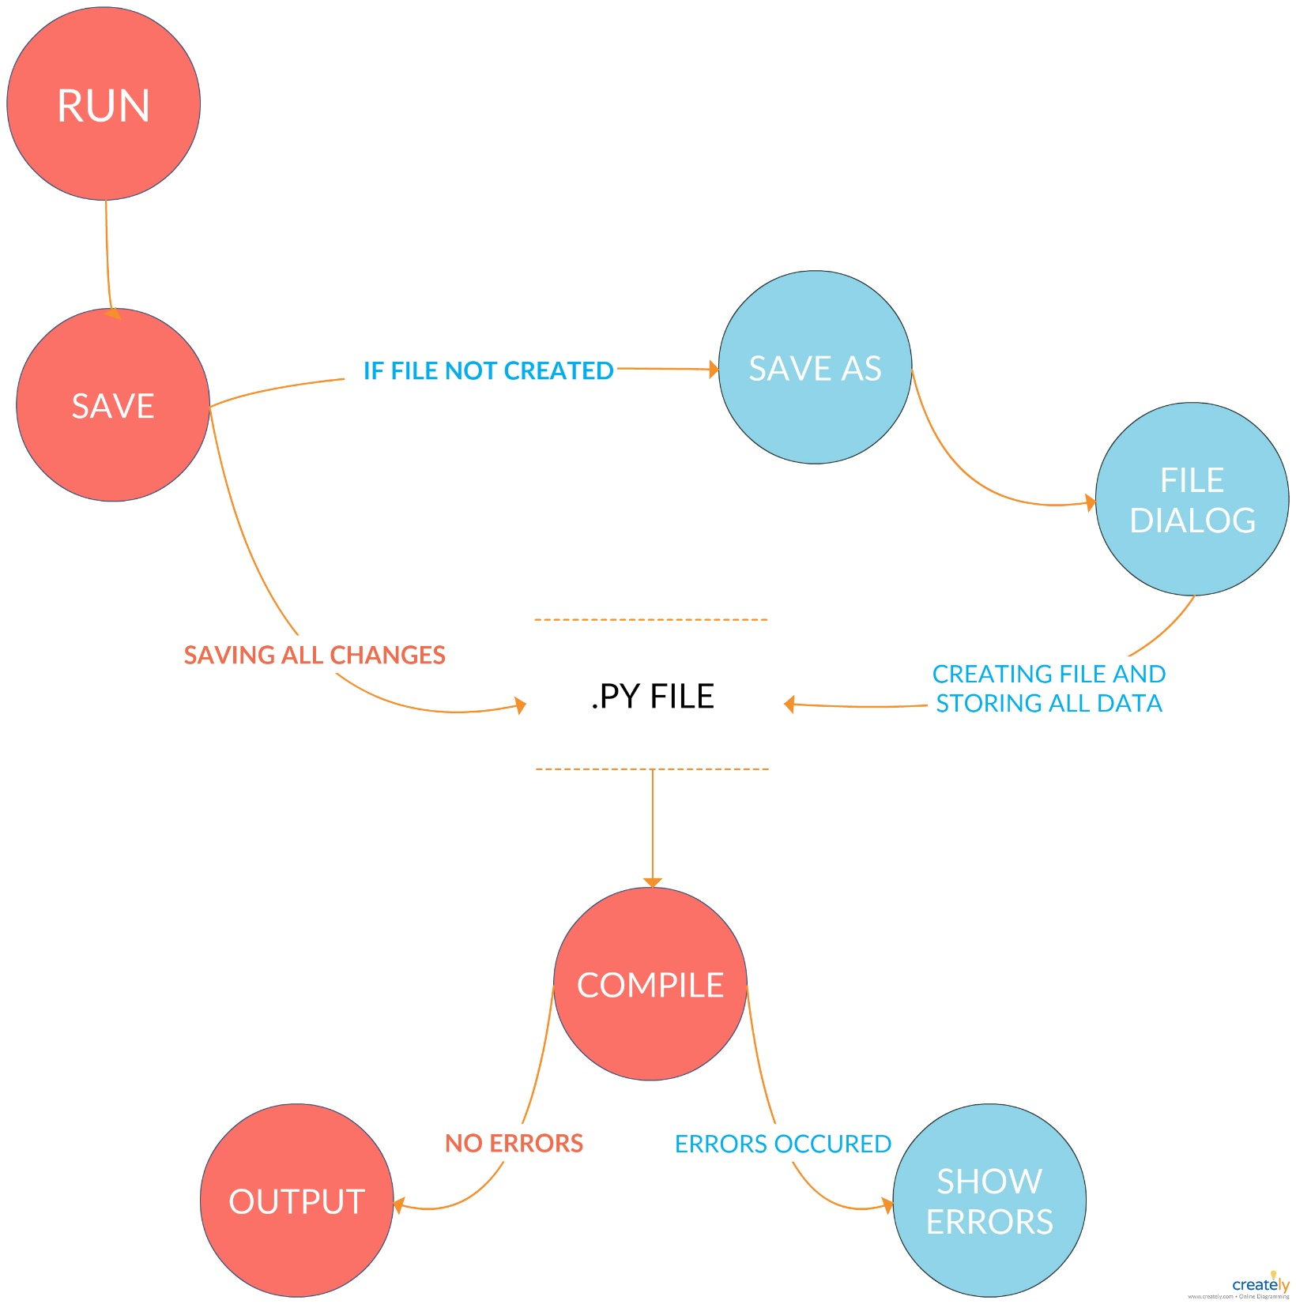

Slide 16
FEATURES OVERVIEW
FEATURES
-> Edit Code Easily.
-> Comes With Basic Features Like Cut, Copy, Paste, Find, Replace And Much More
Options.
-> Comes With Lots Of Shortcut Keys.
-> Easily Write Your Code
-> Save File With Default Python Extension.
-> Easily Run Your Code.
-> Easily Access Python3 Console.
-> Easily Customize Editor Environment.
-> Easily Customize Editor Output Screen.

Slide 17
FEATURES
(EXPLANATION)

Slide 18
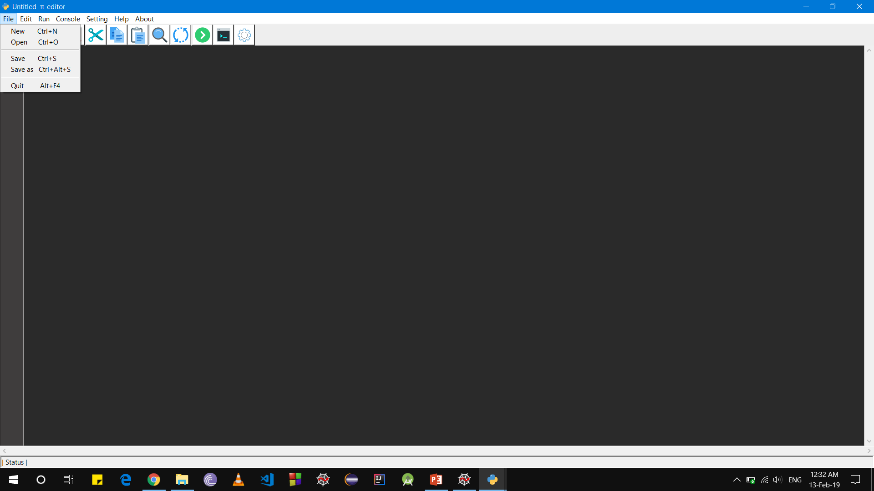
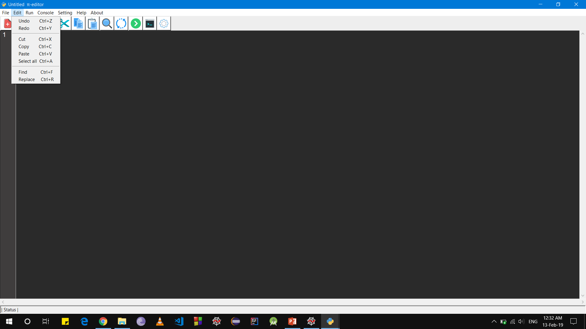
MENU BAR

Slide 19












TOOLBAR
TOOL BAR
Icons | Functions
 | New File
 | Open File
 | Save
 | Save As
 | Cut
 | Copy
Icons | Functions
 | Paste
 | Find
 | Run
 | Replace
 | Console
 | Setting

Slide 20
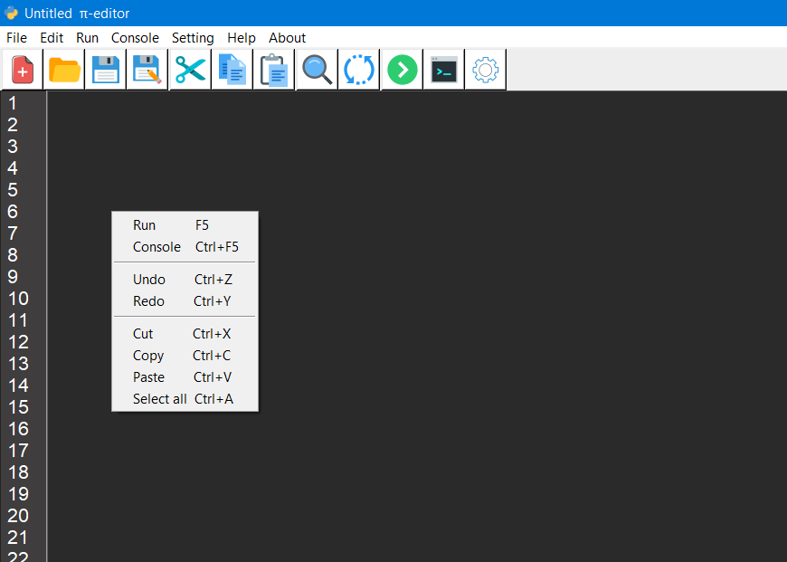

RIGHT CLICK POPUP MENU
Pop-Up Menu
On Right click

Slide 21
SHORTCUT KEYS
SHORTCUT KEYS
Shortcut Keys | Functions
Ctrl+N | New
Ctrl+O | Open
Ctrl+S | Save
Ctrl+Alt+S | Save As
Alt+F4 | Quit
F5 | Run
Ctrl+F5 | Console
Ctrl+A | Select All
Ctrl+F | Find
Ctrl+R | Replace
Ctrl+X/Ctrl+C/Ctrl+V | Cut/Copy/Paste
Ctrl+Z/Ctrl+Y | Undo/Redo
π-editor
Comes with
Lots of
shortcuts
keys

Slide 22
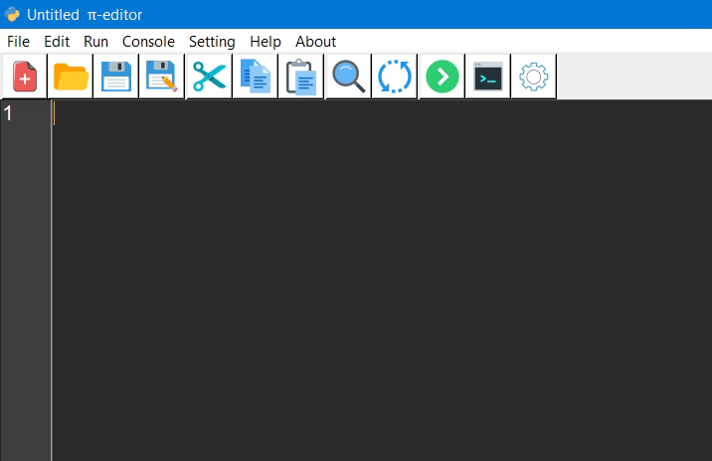
Auto Insertion
AUTO INSERTION
π-editor
Comes with
Auto Insertion
And
Auto Indentation

Slide 23
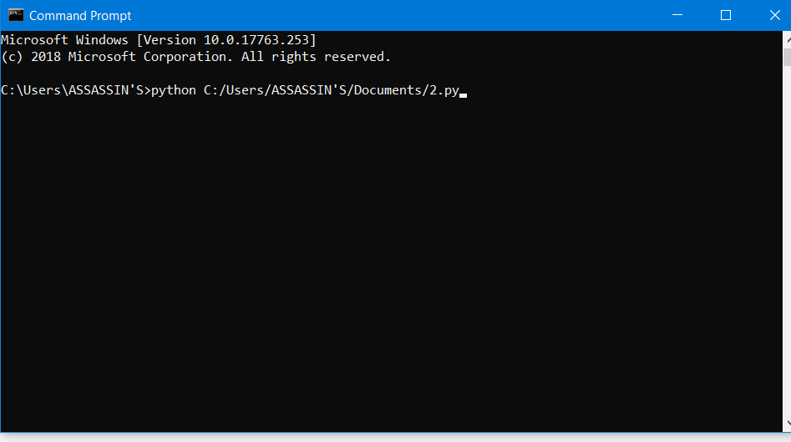
RUN
RUN
Runs Program Directly By One click

Slide 24
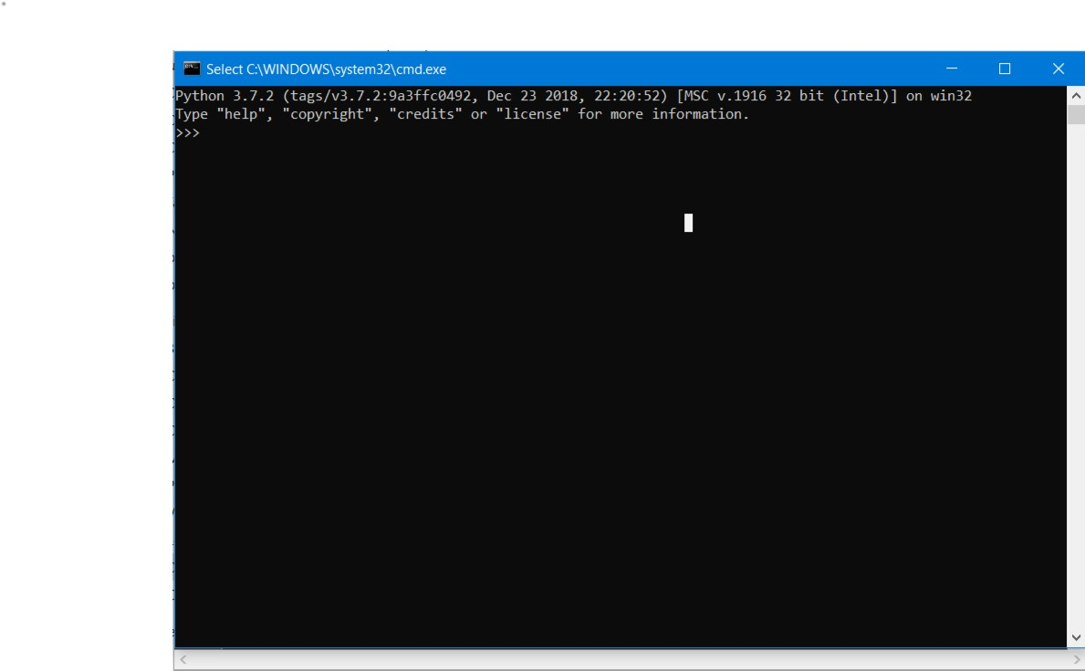
PYTHON3 CONSOLE
PYTHON CONSOLE
Access Python3
Console by one click

Slide 25
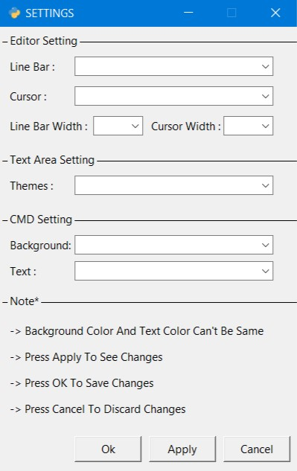
customizations
CUSTOMIZATION
Easily
Customizable
Environment

Slide 26
MIDNIGHT

Slide 27
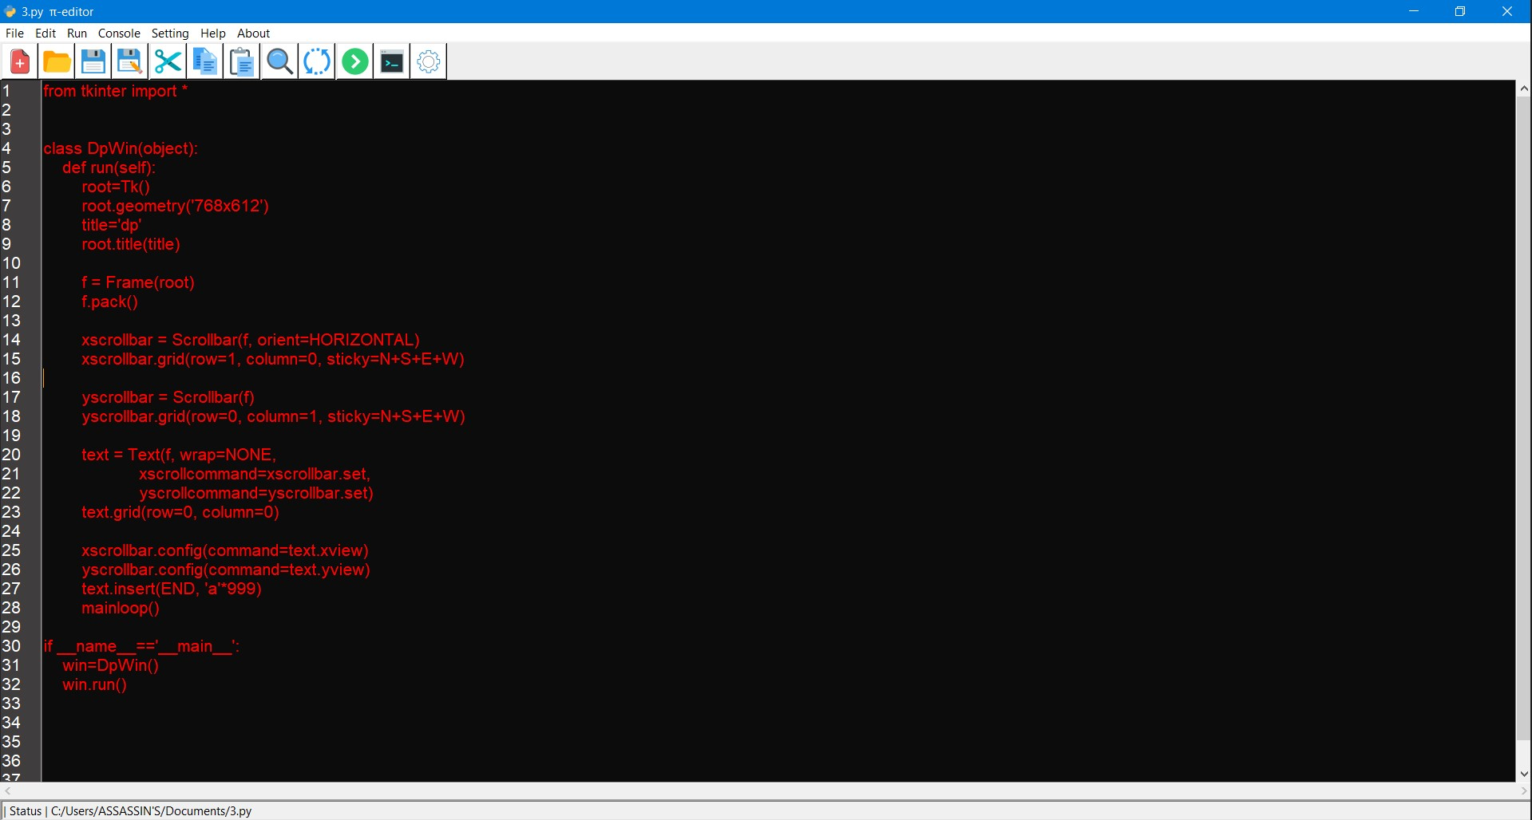
DARK CODE
RED

Slide 28
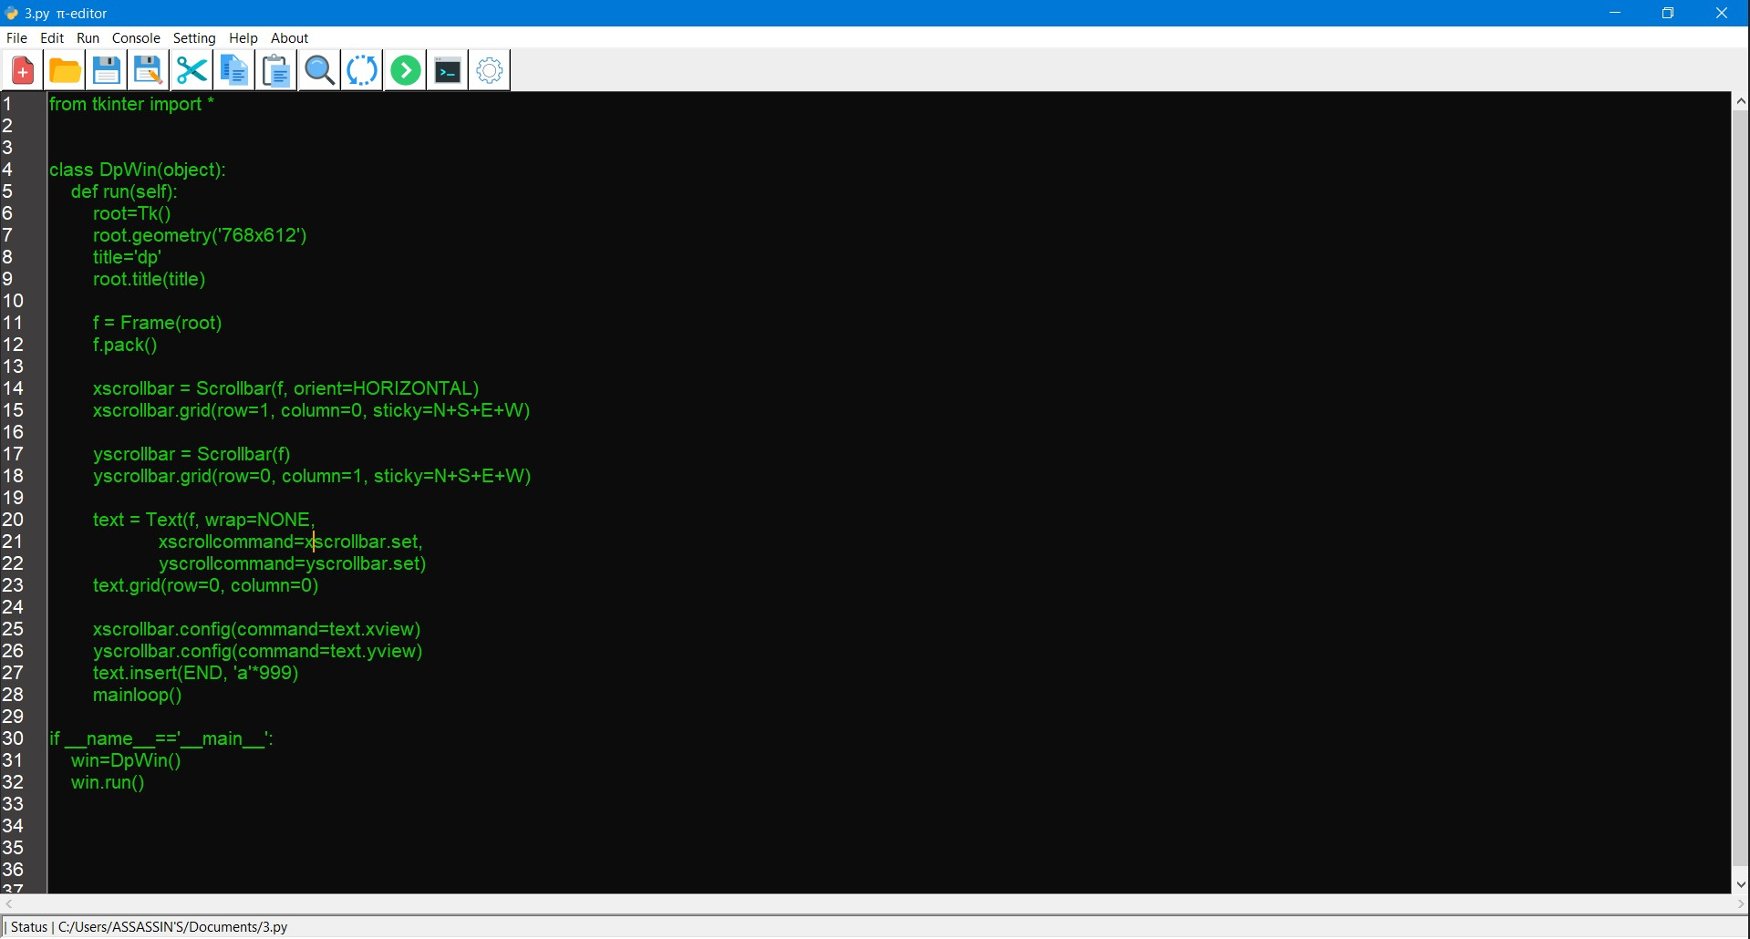
DARK CODE
GREEN

Slide 29
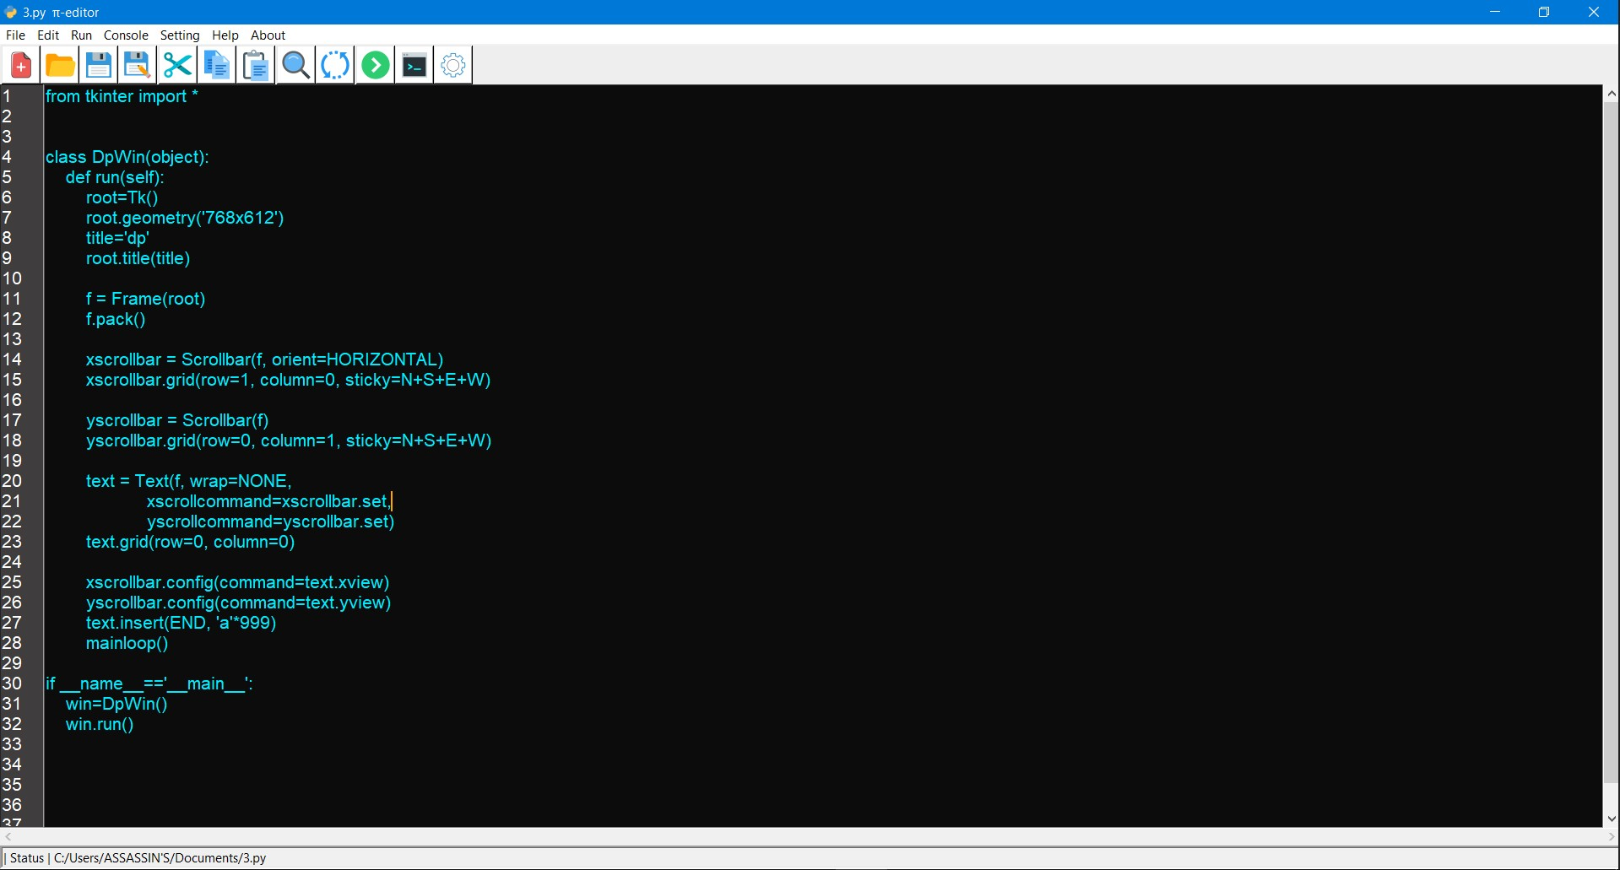
DARK CODE
BLUE

Slide 30
LIGHT

Slide 31
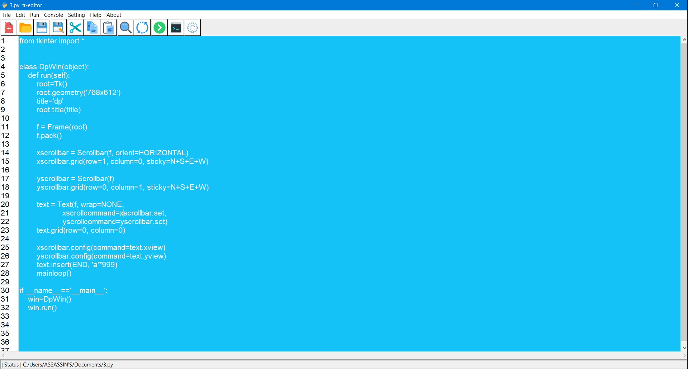
LIGHT SKY

Slide 32
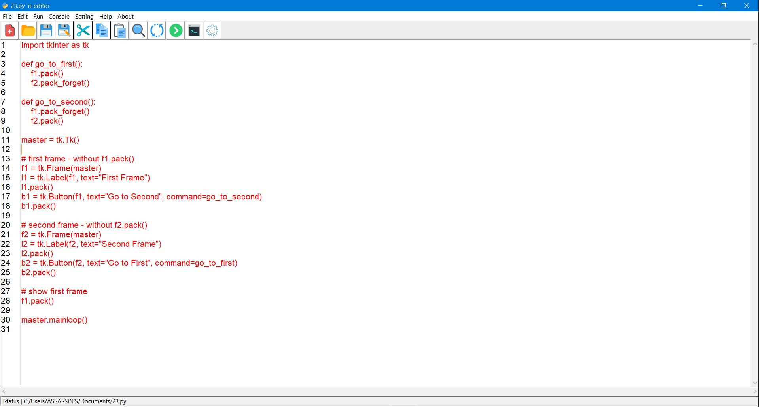
LIGHT CODE
RED

Slide 33
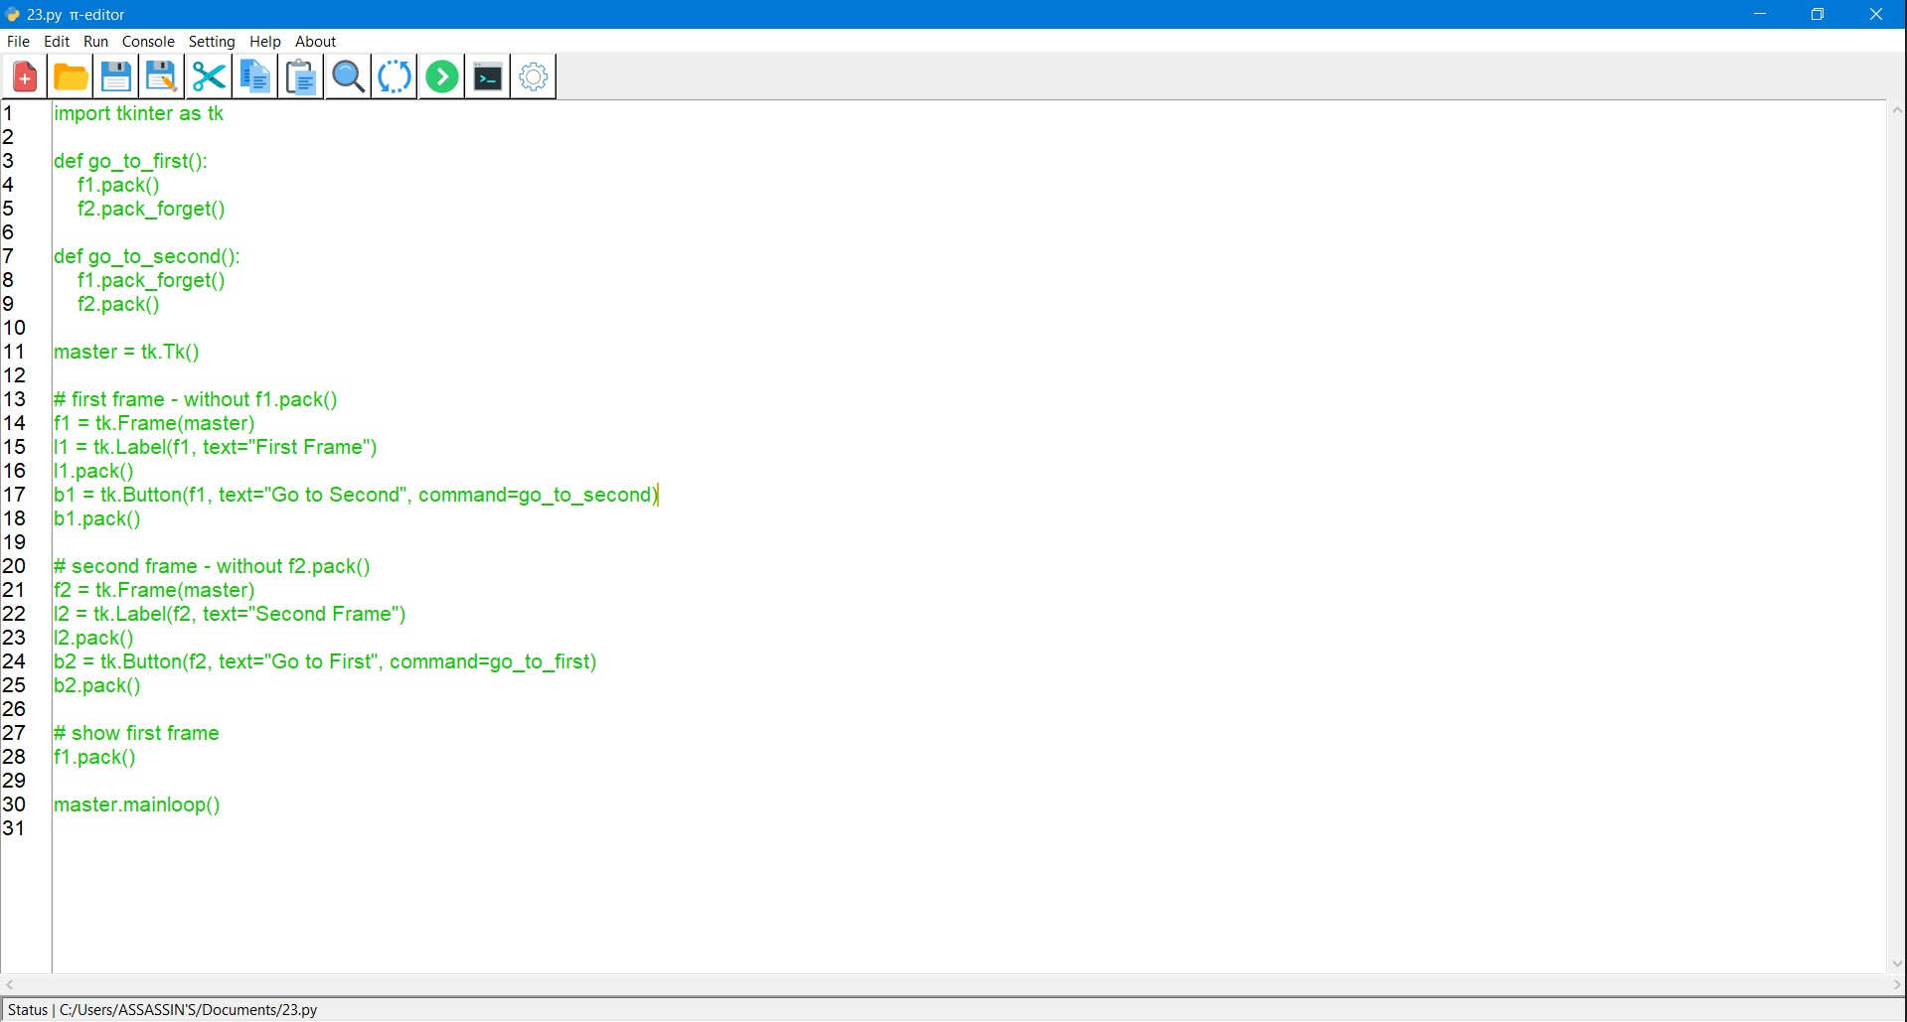
LIGHT CODE
GREEN

Slide 34
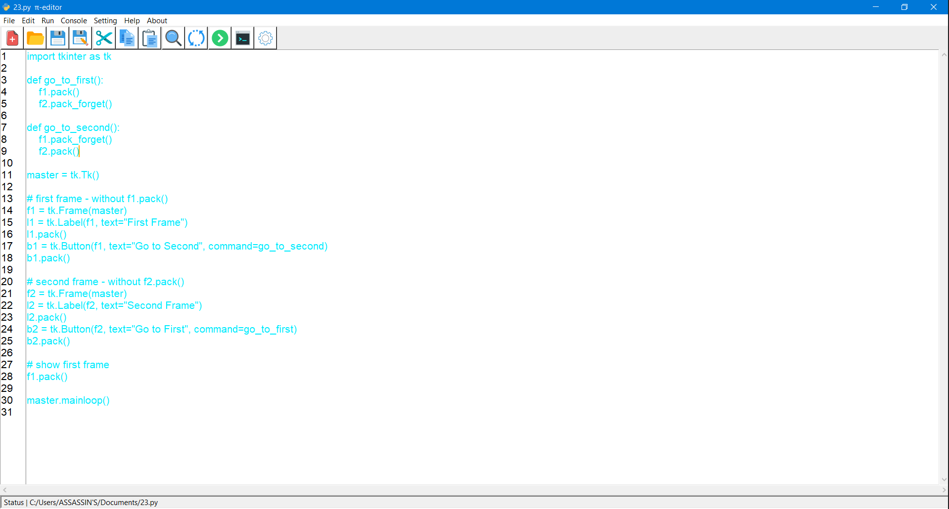
LIGHT CODE
BLUE

Slide 35
THANK YOU

